Slide 1
Best orm to use with .Net Core
March 2021 | Iana Zahvatova

Slide 2
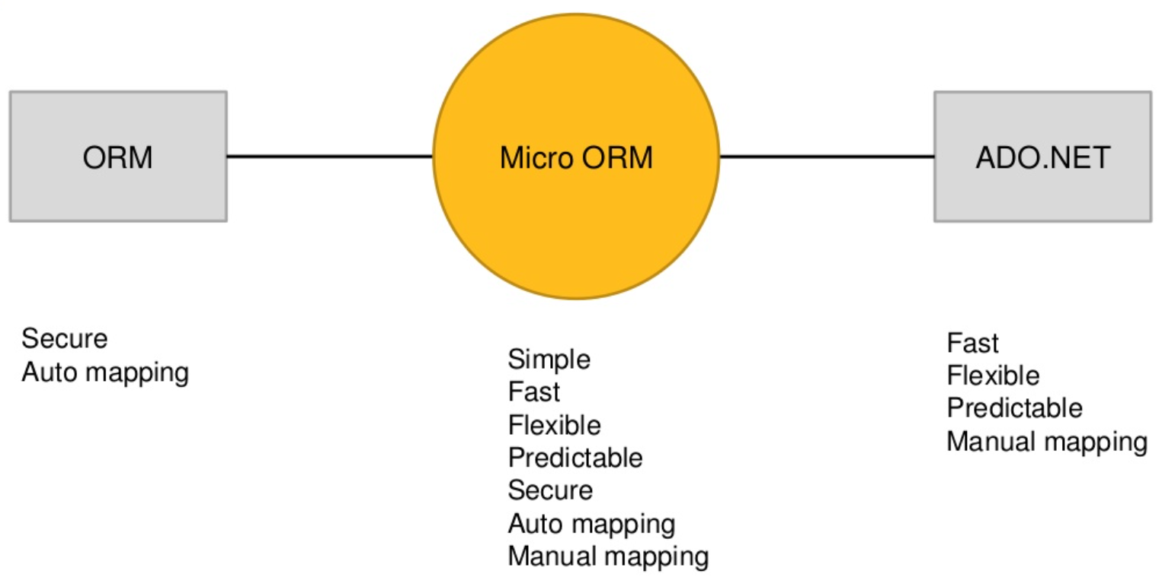
ORM or micro orm … or ado.net???
Migrations
Transactions
Caching

Slide 3

How to choose the orm?

Slide 4
The most popular
Entity Framework Core (192 423 785 total downloads)
Dapper (73 090 138 total downloads)
Dapper.Contrib (6 084 894 total downloads)
NHibernate (13 245 041 total downloads)
FluentNHibernate (6 582 911 total downloads)
Linq2db (1 741 795 total downloads)
*Source https://www.nuget.org/ on 2021-03-09

Slide 5
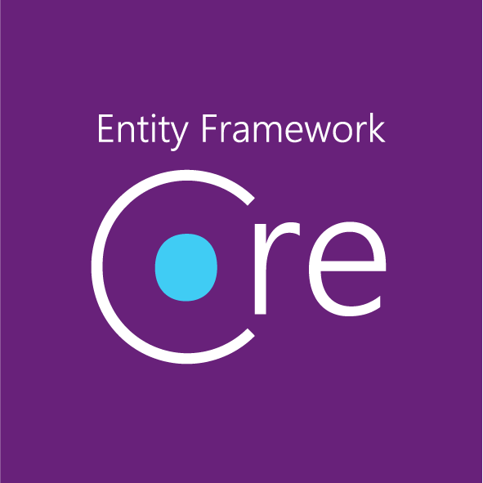
Entity Framework
Entity Framework (EF) is an open source ORM framework for .NET applications supported by Microsoft. EF simplifies mapping between objects in your software to the tables and columns of a relational database.
Easy To Maintain
You can write code against the Entity Framework, and the system will automatically produce objects for you as well as track changes on those objects and simplify the process of updating the database.
The EF can, therefore, replace a large chunk of code you would otherwise have to write and maintain yourself.
Abstraction
The mapping between your objects and your database is specified declaratively instead of in code.
If you need to change your database schema, you can minimize the impact on the code you have to modify in your applications.
It provides a level of abstraction which helps isolate the app from the database.
Easy to Use
The queries and other operations you write into your code are specified in a syntax that is not specific to any particular database.
With the EF, the queries are written in LINQ or Entity SQL and then translated at runtime by the providers to the specific back-end query syntax for that database.

Slide 6

Dapper
Dapper – King of Micro ORM in terms of performance.
Dapper is a popular simple object mapping tool. It is designed primarily to be used in scenarios where you want to work with data in a strongly typed fashion - as business objects in a .NET application, but don't want to spend hours writing code to map query results from ADO.NET data readers to instances of those objects.
Speedy and high performance
Fewer lines of code
Object mapper
Choice of static/dynamic object binding
Easy handling of SQL query
Multiple query support
Support and easy handling of stored procedures
Operating directly on IDbConnection interface
Bulk data insert functionality

Slide 7
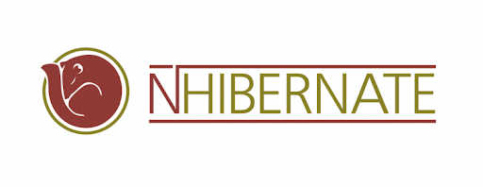
NHibernate
NHibernate is a port of Hibernate from Java, one of the oldest and most respected Object-Relational Mappers.
NHibernate is an open source object relational mapping technology for .Net Framework. It provides the framework required for mapping domain model(classes) to a traditional relational databases and generate queries.
Persist the object in the relation database and can do all CRUD operations in it.
NHibernate does all the database work.
Eliminates the necessity to write SQL statements or create a stored query.
We can have all of our data access logic contained within our application.
Data Cartography, not only will our queries be effective, but they will also be validated by the compiler. Therefore, if our underlying table structure changes, the compiler will alert us that we need to change our queries!
For all Create, Retrieve, Update, and Delete (CRUD) there is no need to write a SQL query.

Slide 8
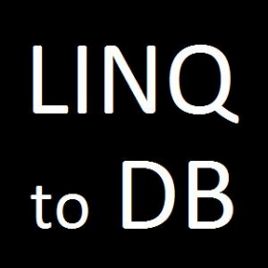
Linq2DB
LINQ to DB is the fastest LINQ database access library offering a simple, light, fast, and type-safe layer between your POCO objects and your database.
Architecturally it is one step above micro-ORMs like Dapper, Massive, or PetaPoco, in that you work with LINQ expressions, not with magic strings, while maintaining a thin abstraction layer between your code and the database. Your queries are checked by the C# compiler and allow for easy refactoring.
However, it's not as heavy as LINQ to SQL or Entity Framework. There is no change-tracking, so you have to manage that yourself, but on the positive side you get more control and faster access to your data.
In other words LINQ to DB is type-safe SQL.
Rich Querying API:
Explicit Join Syntax (In addition to standard LINQ join syntax.)
CTE Support
Bulk Copy/Insert
Window/Analytic Functions
Merge API
Extensibility:
Ability to Map Custom SQL to Static Functions

Slide 9
Entity Framework vs Dapper
Entity Framework
Advantages
Entity Framework allows you to create a model by writing code or using boxes and lines in the EF Designer and generate a new database.
You can write code against the Entity Framework, and the system will automatically produce objects for you as well as track changes on those objects and simplify the process of updating the database.
One common syntax (LINQ) for all object queries whether it is a database or not and pretty fast if used as intended, easy to implement and less coding required to accomplish complex tasks.
The EF can replace a large chunk of code you would otherwise have to write and maintain yourself.
It provides auto-generated code
It reduces development time and cost.
It enables developers to visually design models and mapping of database
EF also supports async database operations.
Disadvantages
You have to think in a non-traditional way of handling data, not available for every database.
If there is any schema change in database FE won't work and you have to update the schema in solution as well.
The EF queries are generated by the provider that we cannot control.
It is not good for a huge domain model.
Lazy loading is the main drawbacks of EF

Slide 10
Entity Framework vs Dapper
DappeR
Advantages
Dapper make it easy to correctly parameterize queries
It can easily execute queries (scalar, multi-rows, multi-grids, and no-results)
Make it easy to turn results into objects
It is very efficient and owns the title of King of Micro ORM in terms of performance.
Disadvantages
Dapper can't generate a class model for you
It cannot generate queries for you
It cannot track objects and their changes
The raw dapper library doesn't provide CRUD features, but the "contrib" additional package does provide basic CRUD.

Slide 11
Entity Framework vs NHibernate
NHibernate
Advantages
NHibernate has flexible and very powerful mapping capabilities.
It supports a second-level cache, that can be used among multiple ISessionFactory
Very polished Unit Of Work implementation.
With NHibernate, you can use mostly any database you want
It's very mature and popular in an enterprise environment.
NHibernate supports different ID generation strategies, coming from the database such as;
Identity (for SQL Server, MySQL, and databases who support identity columns);
Sequence (for Oracle, PostgreSQL, and others who support sequences); etc.
Disadvantages
Increased startup time due to metadata preparation
Huge learning curve without ORM background.
Writing XML mapping can be very tedious especially for big databases with hundreds and thousands of tables and views and stored procedures.
NHibernate falls badly behind with regard to documentation because its process is outdated and resources for learning are scattered all over the Internet.

Slide 12

Entity Framework vs LINQ2db
Linq2DB
Advantages
Very fast
Understandable and easy to learn
Predictable
No redundant features
LINQ
Disadvantages
No lazy and eager loading
No change-tracking
No migrations
No transactions
Краткость –
сестра таланта.

Slide 13
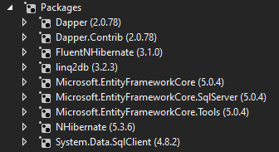
Performance comparison
Add Range 1000 records
Update Range 1000 records
Delete Range 1000 records
Filter by one bool field 500 records from 1000

Slide 14
Add Range 1000 records
Linq2DB x EF

Slide 15
Update Range 1000 records
Nhibernate x dapper

Slide 16
DElete Range 1000 records
EF x Nhibernate

Slide 17
Filter by one bool field 500 records from 1000
Dapper x EF

Slide 18

Performance Winners
Linq2Db (8)
Dapper and NHibernate (10)
Entity Framework (12)

Slide 19
Documentation and simplicity
Entity Framework
Dapper
Linq2Db
NHibernate

Slide 20
syntax
Entity Framework (LINQ) and Dapper (SQL)
Linq2Db (LINQ)
NHibernate (HQL)

Slide 21
Conclusion
Entity Framework + Dapper

Slide 22
DISCLAIMER
This document has been prepared by Amdaris for the sole use of the recipient. The information contained in this documentation is proprietary and confidential to Amdaris and should be kept confidential and not disclosed by the recipient to any other person unless such person has a need to know such information in order to evaluate the contents of this document.
Amdaris has prepared this document in good faith based on the information made available by the recipient to Amdaris. Amdaris reserves the right to make amendments and to correct any errors that are identified. This document is provided to the recipient subject to contract. Nothing in this document or in any related correspondence, discussions or other materials shall be construed as the basis of any contract or a representation which may be relied upon by the recipient unless agreed by Amdaris in the context of a legally binding agreement. No warranty, assurance or undertaking (express or implied) is or will be made, and no responsibility or liability is or will be accepted by Amdaris or any persons employed or engaged by Amdaris in relation to the adequacy, accuracy, completeness or reasonableness of the contents of this document, or of any other information (whether written or oral), notice or document supplied or otherwise made available to the receipt and, to the maximum extent permitted by applicable law, all and any such responsibility and liability is expressly disclaimed.
The following notice applies to this document and should be reproduced by the recipient on any copies which have been made in accordance with this notice.

